Slide 1
Transfer learning
BY : AHMED HAYTHAM
2022-2023

Slide 2
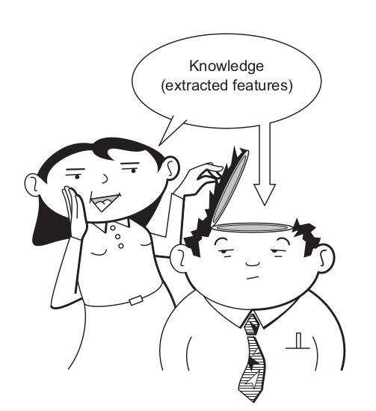

What problems does transfer learning solve ?
As the name implies, transfer learning means transferring what a neural network has learned from being trained on a specific dataset to another related problem
Transfer learning is a great way to shortcut the process of collecting and training huge amounts of data
Data problem
Computation problem

Slide 3
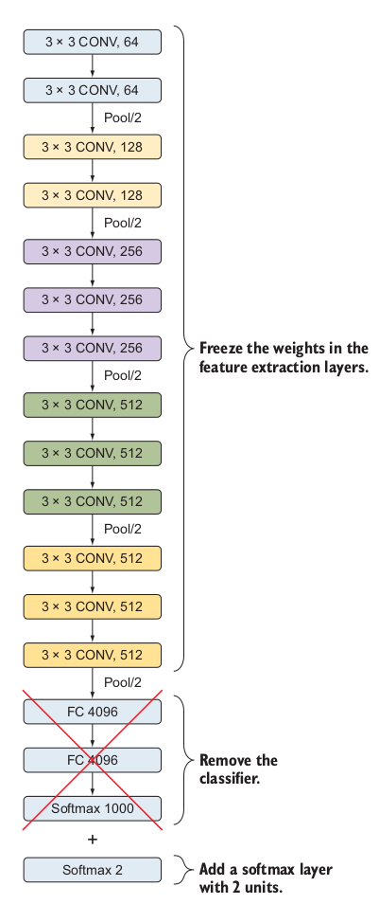
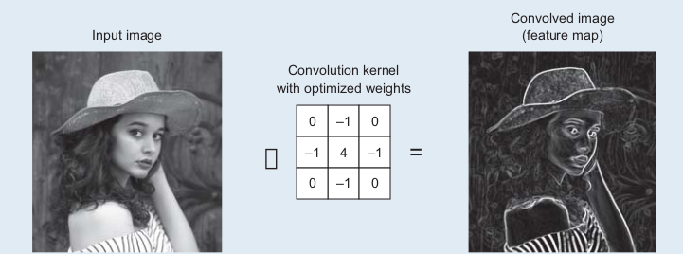
What is transfer learning ?
Transfer learning is the transfer of the knowledge ( feature maps )

Slide 4
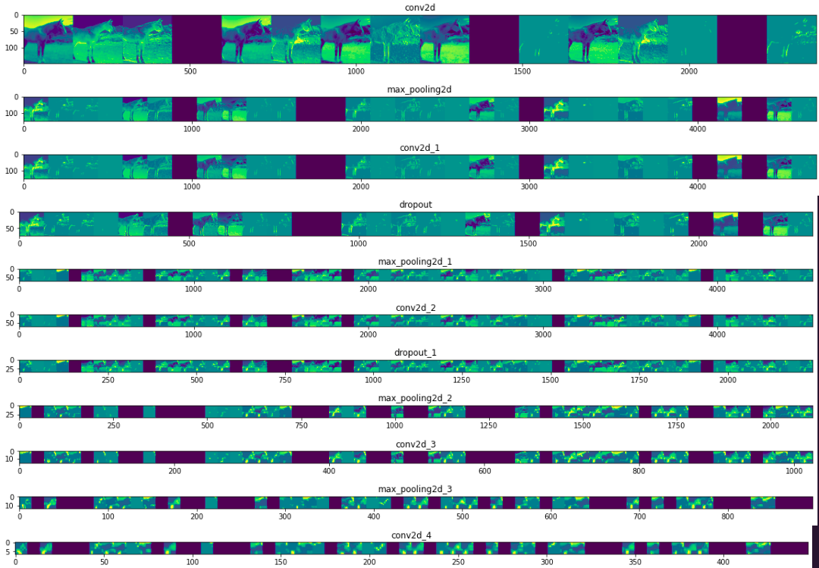
What is transfer learning ?
Transfer learning is the transfer of the knowledge (feature maps)

Slide 5
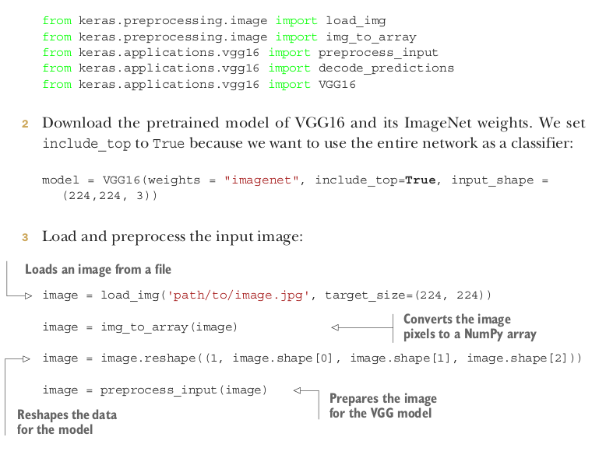

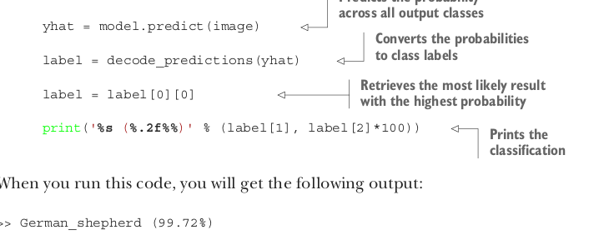

What is transfer learning approaches ?
Using a pretrained network as a classifier

Slide 6
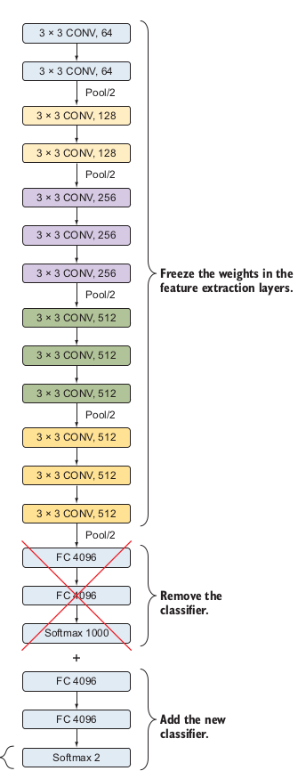



What is transfer learning approaches ?
Feature extraction

Slide 7
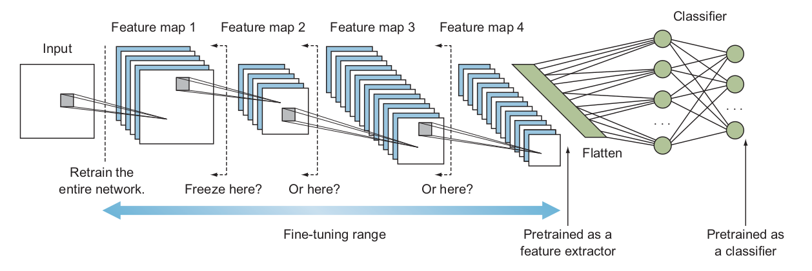
What is transfer learning approaches ?
Fine-tuning range

Slide 8
Scenario 1: Target dataset is small and similar to the source dataset
Pretrained network as a feature extractor

Slide 9
Scenario 2: Target dataset is large and similar to the source dataset
1_ Pretrained network as a feature extractor
2_ Fine-tune through the full network

Slide 10
Scenario 3: Target dataset is small and different from the source dataset
1_ Fine-tune from activations earlier in the network

Slide 11
Scenario 4: Target dataset is large and different from the source dataset
1_ Fine-tune through the entire network

Slide 12
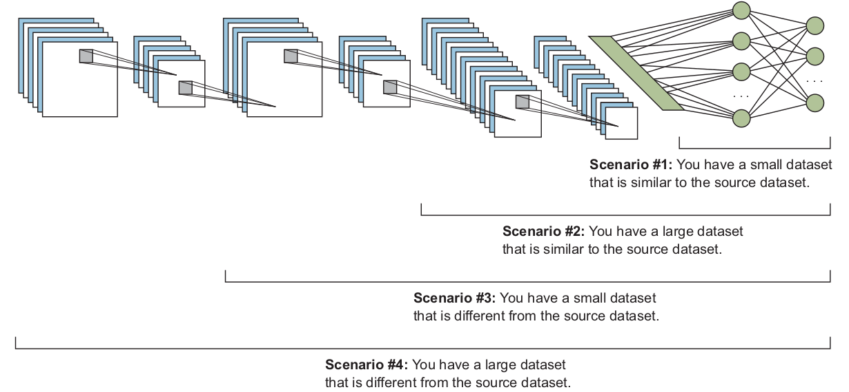
Recap

Slide 13
Thank
You

